Slide 1
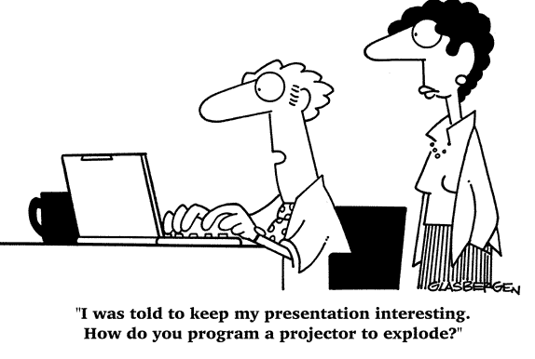
Introduction to Project Management

Slide 2
Why Should We Use Information Technology (IT) Project Management
IT Projects have a terrible track record
  A 1995 Standish Group study (CHAOS) found that only 16.2% of IT projects were successful and over 31% were canceled before completion, costing over $81 B in the U.S. alone
The need for IT projects keeps increasing
  In 1998, corporate America issued 200,000 new-start application development projects
  In 2000, there were 300,000 new IT projects, and
  In 2001, over 500,000 new IT projects were started

Slide 3
Advantages of Project Management
Better control of financial, physical, and human resources
Improved customer relations
Shorter development times
Lower costs
Higher quality and increased reliability
Higher profit margins
Improved productivity
Better internal coordination
Higher worker morale

Slide 4
What Is a Project?
A project is a temporary endeavor undertaken to accomplish a unique purpose
Attributes of projects
  unique purpose
  temporary
  require resources, often from various areas
  should have a primary sponsor and/or customer
  involve uncertainty

Slide 5
Samples of IT Projects
Northwest Airlines developed a new reservation system called ResNet (see chapters 11-16)
Many organizations upgrade hardware, software, and networks via projects
  Upgrade computers at college
  Touch-Tone class registration
Organizations develop new software or enhance existing systems to perform many business functions
  Portland Water Bureau

Slide 6
The Triple Constraint
Every project is constrained in different ways by its
  Scope goals: What is the project trying to accomplish?
  Time goals: How long should it take to complete?
  Cost goals: What should it cost?
It is the project manager’s duty to balance these three often competing goals

Slide 7
The 2001 Standish Group Report
Time overruns significantly decreased to 63% compared to 222%
Cost overruns were down to 45% compared to 189%
Required features and functions were up to 67% compared to 61%
78,000 U.S. projects were successful compared to 28,000
28% of IT projects succeeded compared to 16%

Slide 8
Why the Improvements?
"The reasons for the increase in successful projects vary. First, the average cost of a project has been more than cut in half. Better tools have been created to monitor and control progress and better skilled project managers with better management processes are being used. The fact that there are processes is significant in itself.“*
The Standish Group, "CHAOS 2001: A Recipe for Success" (2001)

Slide 9
What is Project Management?
Project management is “the application of knowledge, skills, tools, and techniques to project activities in order to meet project requirements” (PMI*, Project Management Body of Knowledge (PMBOK Guide), 2000, p. 6)
*The Project Management Institute (PMI) is an international professional society. Their web site is www.pmi.org.

Slide 10
Project Stakeholders
Stakeholders are the people involved in or affected by project activities
Stakeholders include
  the project sponsor and project team
  support staff
  customers
  users
  suppliers
  opponents to the project

Slide 11
9 Project Management Knowledge Areas
Knowledge areas describe the key competencies that project managers must develop
  4 core knowledge areas lead to specific project objectives (scope, time, cost, and quality)
  4 facilitating knowledge areas are the means through which the project objectives are achieved (human resources, communication, risk, and procurement management
  1 knowledge area (project integration management) affects and is affected by all of the other knowledge areas

Slide 12
Project Management Tools and Techniques
Project management tools and techniques assist project managers and their teams in various aspects of project management
Some specific ones include
  Project Charter and WBS (scope)
  Gantt charts, network diagrams, critical path analysis, critical chain scheduling (time)
  Cost estimates and earned value management (cost)

Slide 13
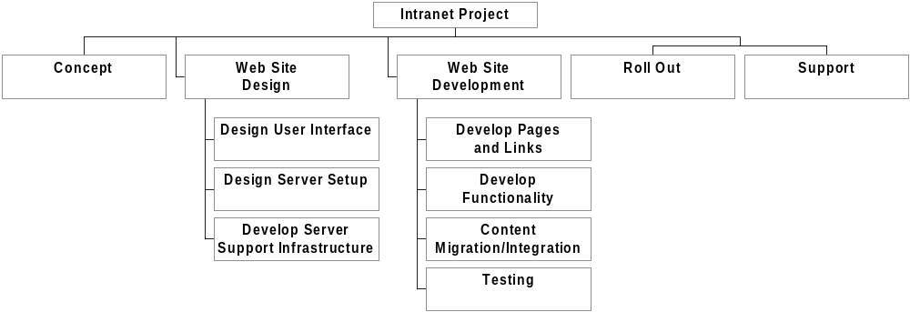
Sample WBS for Intranet Project in Chart Form

Slide 14
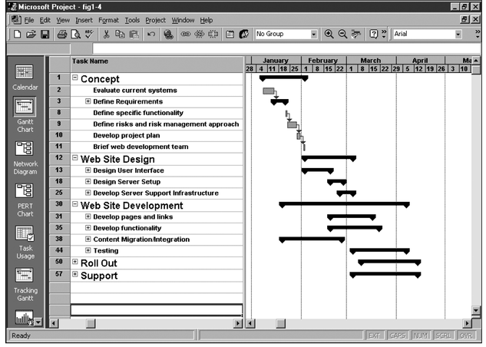
Figure 1-4. Sample Gantt Chart
The WBS is on the left, and each task’s start and finish date
are shown on the right using a calendar timescale.

Slide 15
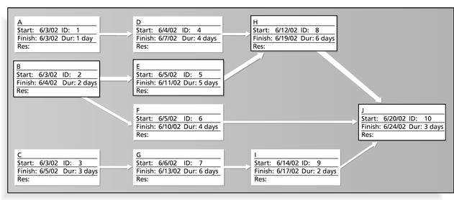
Figure 1-5. Sample Network Diagram
Each box is a project task from the WBS. Arrows show dependencies
between tasks. The bolded tasks are on the critical path. If any tasks on the
critical path take longer than planned, the whole project will slip
unless something is done.

Slide 16
More Advantages of Project Management
Bosses, customers, and other stakeholders do not like surprises
Good project management (PM) provides assurance and reduces risk
PM provides the tools and environment to plan, monitor, track, and manage schedules, resources, costs, and quality
PM provides a history or metrics base for future planning as well as good documentation
Project members learn and grow by working in a cross-functional team environment

Slide 17
History of Project Management
Modern project management began with the Manhattan Project, which the U.S. military led to develop the atomic bomb
In 1917 Henry Gantt developed the Gantt chart as a tool for scheduling work in job shops
In 1958, the Navy developed PERT charts
In the 1970s, the military began using project management software, as did the construction industry
By the 1990s, virtually every industry was using some form of project management

Slide 18
The Project Management Profession
A 1996 Fortune article called project management the “number one career choice”
Professional societies like the Project Management Institute (PMI) have grown tremendously
Average salaries for project managers are over $81,000

Slide 19
Project Management Knowledge Continues to Grow and Mature
PMI hosted their first research conference in June 2000 in Paris, France
The PMBOK Guide – 2000 Edition is an ANSI standard
PMI’s certification department earned ISO 9000 certification
Hundreds of new books, articles, and presentations related to project management have been written in recent years

Slide 20
How Project Management (PM) Relates to Other Disciplines
Much of the knowledge needed to manage projects is unique to PM
However, project managers must also have knowledge and experience in
  general management
  the application area of the project
Project managers must focus on meeting specific project objectives

Slide 21
Project Management Software
By 2001, there were hundreds of different products to assist in performing project management
Three main categories of tools:
  Low-end tools: Handle single or smaller projects well, cost under $200 per user
  Midrange tools: Handle multiple projects and users, cost $200-500 per user, Project 2000 most popular
  High-end tools: Also called enterprise project management software, often licensed on a per-user basis

Slide 22
Chapter 2:
The Project Management Context and Processes

Slide 23
Projects Cannot Be Run In Isolation
Projects must operate in a broad organizational environment
Project managers need to take a holistic or systems view of a project and understand how it is situated within the larger organization
See example in opening and closing case to illustrate this concept

Slide 24
A Systems View of Project Management
A systems approach emerged in the 1950s to describe a more analytical approach to management and problem solving
Three parts include:
  Systems philosophy: View things as systems, interacting components working within an environment to fulfill some purpose
  Systems analysis: problem-solving approach
  Systems management: Address business, technological, and organizational issues before making changes to systems

Slide 25
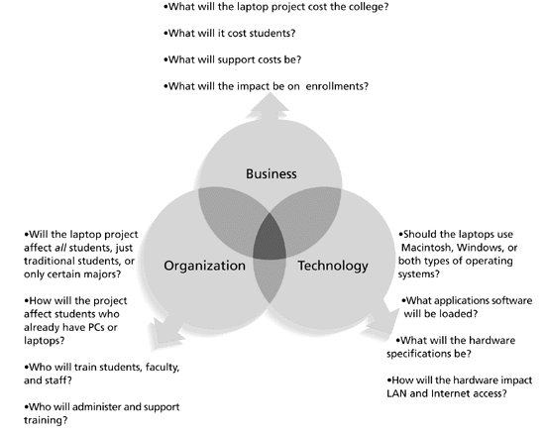
Figure 2-1. Three Sphere Model for Systems Management

Slide 26
Project Phases and the Project Life Cycle
A project life cycle is a collection of project phases
Project phases vary by project or industry, but some general phases include
  concept
  development
  implementation
  support

Slide 27
Product Life Cycles
Products also have life cycles
The Systems Development Life Cycle (SDLC) is a framework for describing the phases involved in developing and maintaining information systems
Typical SDLC phases include planning, analysis, design, implementation, and support

Slide 28
Sample SDLC Models
Waterfall model: has well-defined, linear stages of systems development and support
Spiral model: shows that software is developed using an iterative or spiral approach rather than a linear approach
Incremental release model: provides for progressive development of operational software
RAD model: used to produce systems quickly without sacrificing quality
Prototyping model: used for developing prototypes to clarify user requirements

Slide 29
Distinguishing Project Life Cycles and Product Life Cycles
The project life cycle applies to all projects, regardless of the products being produced
Product life cycle models vary considerably based on the nature of the product
Most large IT products are developed as a series of projects
Project management is a done is all of the product life cycle phases

Slide 30
Why Have Project Phases and Management Reviews?
A project should successfully pass through each of the project phases in order to continue on to the next
Management reviews (also called phase exits or kill points) should occur after each phase to evaluate the project’s progress, likely success, and continued compatibility with organizational goals

Slide 31
What Went Right?
"The real improvement that I saw was in our ability to⎯in the words of Thomas Edison⎯know when to stop beating a dead horse.…Edison's key to success was that he failed fairly often; but as he said, he could recognize a dead horse before it started to smell...as a result he had 14,000 patents and was very successful…In IT we ride dead horses⎯failing projects⎯a long time before we give up. But what we are seeing now is that we are able to get off them; able to reduce cost overrun and time overrun. That's where the major impact came on the success rate.”
  Cabanis, Jeannette, "'A Major Impact': The Standish Group's Jim Johnson On Project Management and IT Project Success," PM Network, PMI, September 1998, p. 7

Slide 32
Understanding Organizations
Structural frame: Focuses on roles and responsibilities, coordination and control. Organization charts help define this frame.
Human resources frame: Focuses on providing harmony between needs of the organization and needs of people.
Political frame: Assumes organizations are coalitions composed of varied individuals and interest groups. Conflict and power are key issues.
Symbolic frame: Focuses on symbols and meanings related to events. Culture is important.

Slide 33
What Went Wrong?
Many data warehousing projects are side-tracked or derailed completely by politics. Data warehousing projects are always potentially political because they cross departmental boundaries, change both the terms of data ownership and data access, and affect the work practices of highly autonomous and powerful user communities. Many organizations fail to admit that many data warehousing projects fail primarily because management and project teams do not understand and manage politics. Marc Demarest found over 1200 articles on the topic of data warehousing based on a journal search he did from July 1995 to July 1996. Many of those articles offer advice on how to run successful data warehousing projects and focus on the importance of design, technical, and procedural factors, when, in fact, political factors are often the most important in helping these projects succeed.

Slide 34
Many Organizations Focus on the Structural Frame
Most people understand what organizational charts are
Many new managers try to change organizational structure when other changes are needed
3 basic organization structures
  functional
  project
  matrix

Slide 35
Recognize the Importance of Project Stakeholders
Recall that project stakeholders are the people involved in or affected by project activities
Project managers must take time to identify, understand, and manage relationships with all project stakeholders
Using the four frames of organizations can help meet stakeholder needs and expectations
Senior executives are very important stakeholders

Slide 36
What Helps Projects Succeed?
According to the Standish Group’s report CHAOS 2001: A Recipe for Success, the following items help IT projects succeed, in order of importance:
  Executive support
  User involvement
  Experience project manager
  Clear business objectives
  Minimized scope
  Standard software infrastructure
  Firm basic requirements
  Formal methodology
  Reliable estimates

Slide 37
Need for Top Management Commitment
Several studies cite top management commitment as one of the key factors associated with project success
Top management can help project managers secure adequate resources, get approval for unique project needs in a timely manner, receive cooperation from people throughout the organization, and learn how to be better leaders

Slide 38
Need for Organizational Commitment to Information Technology (IT)
If the organization has a negative attitude toward IT, it will be difficult for an IT project to succeed
Having a Chief Information Officer (CIO) at a high level in the organization helps IT projects
Assigning non-IT people to IT projects also encourage more commitment

Slide 39
Need for Organizational Standards
Standards and guidelines help project managers be more effective
Senior management can encourage
  the use of standard forms and software for project management
  the development and use of guidelines for writing project plans or providing status information
  the creation of a project management office or center of excellence

Slide 40
15 Project Management Job Functions*
Evaluate project requirements
Identify and evaluate risks Prepare contingency plan
Identify interdependencies
Identify and track critical milestones
Participate in project phase review
Secure needed resources
Manage the change control process
Report project status
Define scope of project
Identify stakeholders, decision-makers, and escalation procedures
Develop detailed task list (work breakdown structures)
Estimate time requirements
Develop initial project management flow chart
Identify required resources and budget
*Northwest Center for Emerging Technologies, "Building a Foundation for Tomorrow: Skills Standards for Information Technology,"Belleview, WA, 1999

Slide 41
Suggested Skills for a
Project Manager
    Communication skills: listening, persuading
    Organizational skills: planning, goal-setting, analyzing
    Team Building skills: empathy, motivation, esprit de corps
    Leadership skills: sets example, energetic, vision (big picture), delegates, positive
    Coping skills: flexibility, creativity, patience, persistence
    Technological skills: experience, project knowledge

